Slide 1




Notes:
Hi, Folks Thanks for joining. I’ll be sharing info about the Company Cup, which runs alongside the Entelect Challenge initiative that you may already be familiar with.

Slide 2

AGENDA
What
Why
How
When
Pro Tips

Slide 3

What is: The Entelect Challenge?
Coding competition 10th anniversary R200 000 in prizes Video game inspired 118 Entries already submitted

Slide 4

What is: The Company Cup?
Teams of 2-3 Entelectuals
Option to participate solo*
4 Hour Hackathon
An optimisation problem i.e. no bot building
2020
8 teams joined, 13 on the leader board
*solo entries not allegeable for prizes

Slide 5


Why Participate?
WIN!
PER PERSON
+ Spot Prizes

Slide 6

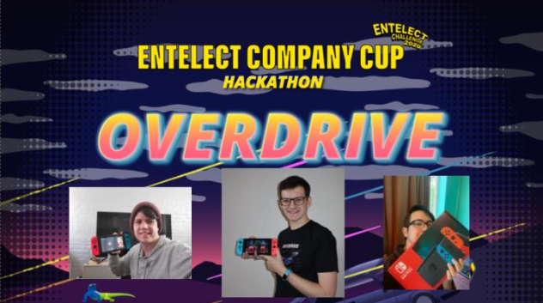

Last Year’s Winners
Joshua Wilmott
Stephan Nel
Jefferey Russell

Slide 7
How To Enter
https://challenge.entelect.co.za
?

Slide 8

When Is The Hackathon?
Wednesday, 21 July
4 – 8 PM
OR
Thursday, 22 July
4 – 8 PM

Slide 9
Pro Tips
Setup Beforehand
Project in your favourite IDE and language
Boilerplate
Simple classes to ingest JSON and output text files

Slide 10
LET’S HAVE A BLAST!
LET’S HAVE A BLAST!
Notes:
Hi, Folks Thanks for joining. I’ll be sharing info about the Company Cup, which runs alongside the Entelect Challenge initiative that you may already be familiar with.

